Slide 1

Snapshotting in HDFS for HOPS
Master of Science Thesis Defence -Pushparaj
Supervisor:Prof. Luís Manuel Antunes Veiga
Notes:
Snapshot
means capturing the state of the storage system at an exact point in time and is used to provide full
recovery of data when lost

Slide 2
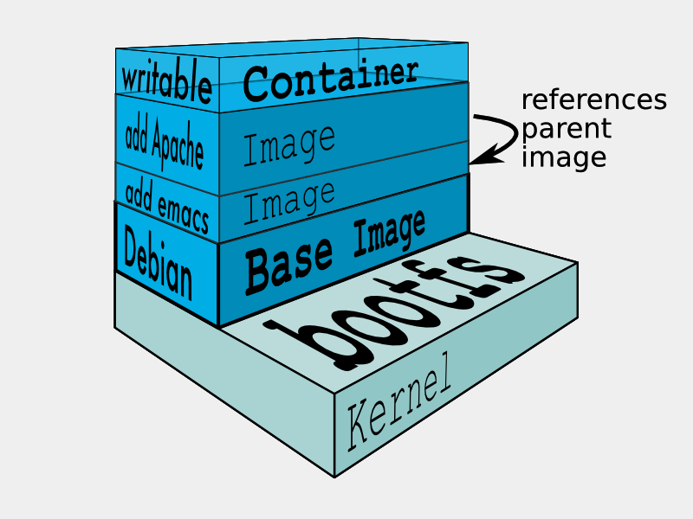
Docker-UnionFs

Slide 3
Introduction
What is Snapshot

Slide 4
Snapshot -Usecases
Software Upgrades
Rollback from Errors

Slide 5
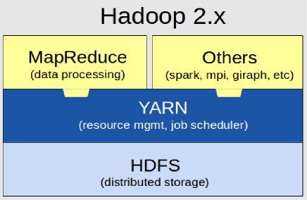
Hadoop

Slide 6
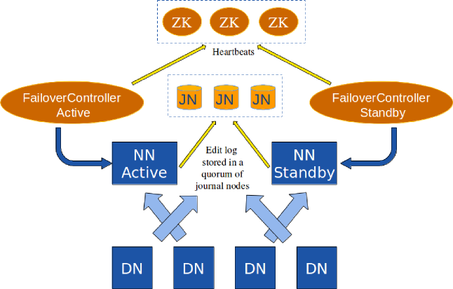
HDFS v2 NameNode Primary/Secondary Replication Model

Slide 7
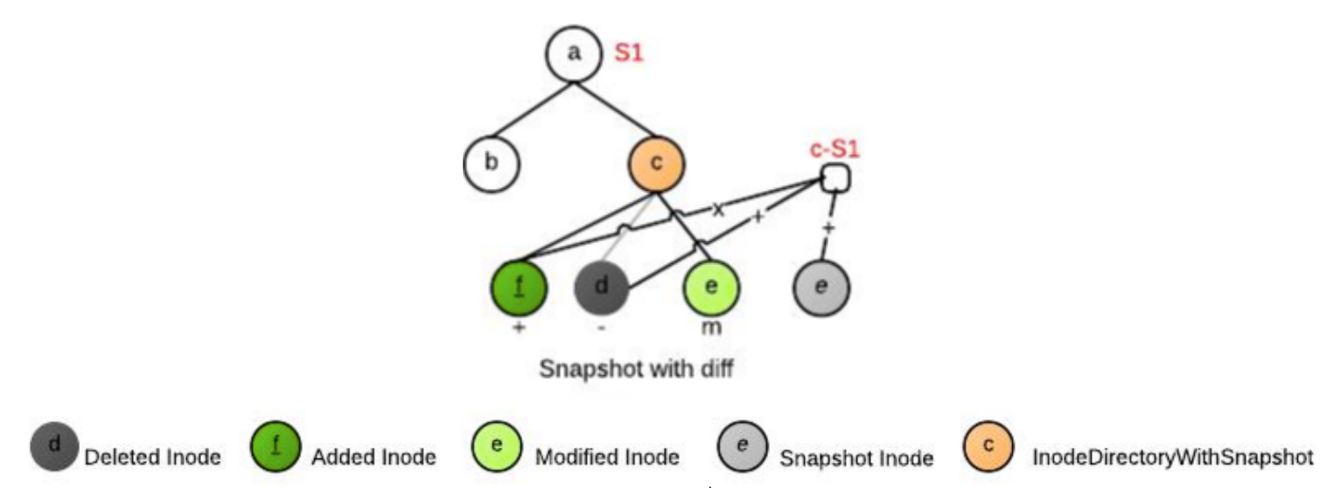
Related Work
Apache HDFS-Snapshots

Slide 8
Related Work: Apache Vesrion 2
Operational costs
○ Modification of a file/directory is O(log (diff size))
○ Access time for current files and directories is unchanged
○ Access time for snapshot files and directories has additional cost of O(log (diff size))
Storage costs - Proportional to the unique modifications since the snapshot is taken - O(M)

Slide 9
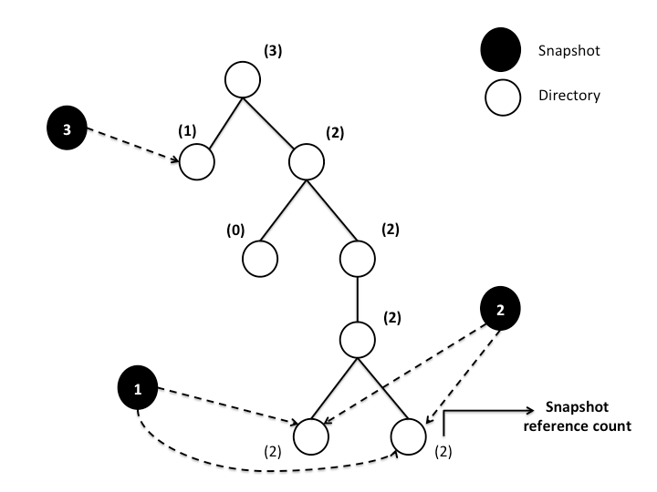
Related Work: Facebook

Slide 10
Related Work: Facebook
Selective Copy-On Appends
  Copy-On Write
    Appends followed by Truncate
  Use Pointers Otherwise.
Overhead of building Snapshot tree
Time to take Snapshot Scales linearly.

Slide 11
Limitations
Still Multi-Readers,Single-Writer,
Whole NameSystem lock.
Secondary NameNode takes >10 sec to server fully.
DataNodes need to know the primary NameNode by using a Zookeeper service which requires atleast three nodes.

Slide 12
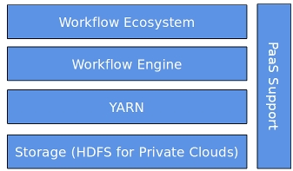
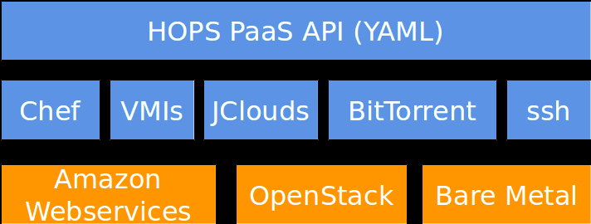
Hadoop Open Platform as Service

Slide 13
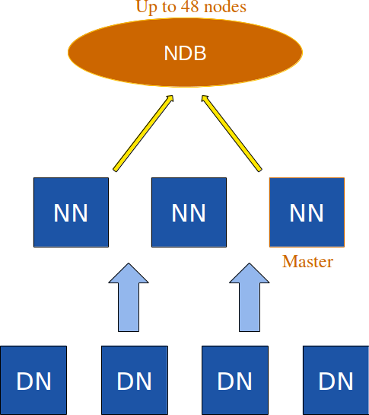
HOP-HDFS

Slide 14
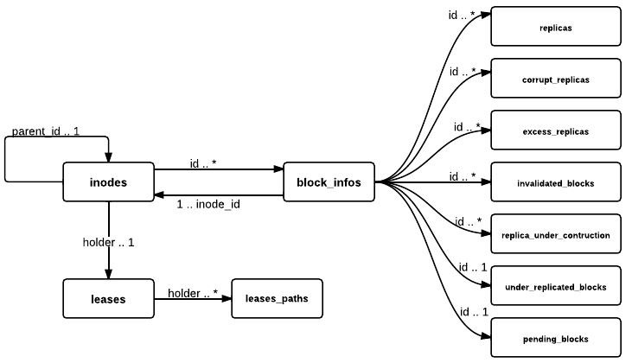
Entity-Relation Diagram for NameNode state in Hop-HDFS

Slide 15
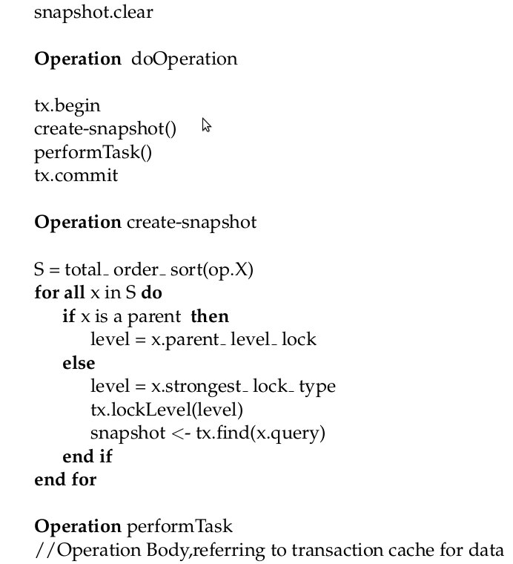
Hop-Hdfs Operations

Slide 16
Challenges
Time to take Snapshot—O(1)
Scale for Terabytes of Metadata(HDFS)
Efficient RollBack
Low Space Overhead on Snapshot metadata

Slide 17
Solutions
Read-Only(RO) Snapshots
RO Nested Snapshots
  General Purpose file/directory level multiple/nested Snapshots.
RO Root Level Single Snapshot
  Specific for Rollback on Software Upgrades

Slide 18
Read-Only Root Level Single Snapshot(ROSS)
isDeleted
0 ==> Inode is not deleted.
1 ==> Inode deleted after Root Level snapshot was taken.
status
0 ==> Inode was created before taking Snapshot.
2 ==> Inode created before taking snapshot but modified after that.
3 ==> Inode was created after taking snapshot.
Notes:
Explain the rules here itself.

Slide 19
Deletion of Directories
atomic{
Set isDeleted=1 for this directory
}
Process the children in depth-first manner.
If file status=3,
  atomic{
  permanently delete blocks
  delete the inode row.
  }
Atomic construct to guarantee consistency of metadata in case of NameNode failure.

Slide 20
RollBack
For INodes:
Delete from INodes where status=2 or status=3
Update INodes set isDeleted=0 where id>0 and isDeleted=1
Update INodes set id = -id, parent id = -parent id where id<0
For Blocks:
Delete from Block Info where status=2 or status=3
Update Block Info set block id = -block id, inode id = -inode id where id<0
Delete from Block Info where block id<0

Slide 21
Implementation-RollBack
Take subTreeOpLock on root
Take read-lock on all rows
Task1
  Delete Inodes with status=2 or Status=3
Task2
  Set isDeleted=0 for inodes isDeleted=1 and id>0
Task3
  Update inodes set id=-id, parent_id=-parent_id where id<0;
  Deleted inodes where id<0;

Slide 22
Implementation-RollBack
Task1, Task2, Task3 are executed on thread pool with batch size 100,000
Failure Handling:
  Insert row with Task Id , NameNode Id,status
  If( status=InProgress && Namenode is dead)
  Leader assigns the task to another namenode.
  Since Task1, Task2, Task3 are Idempotent, progress is guaranteed.

Slide 23
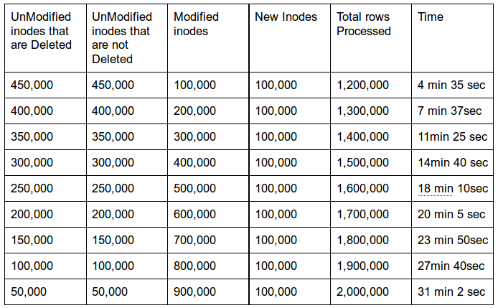
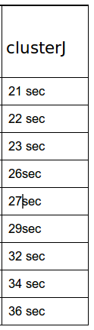
Evaluation-RollBack

Slide 24
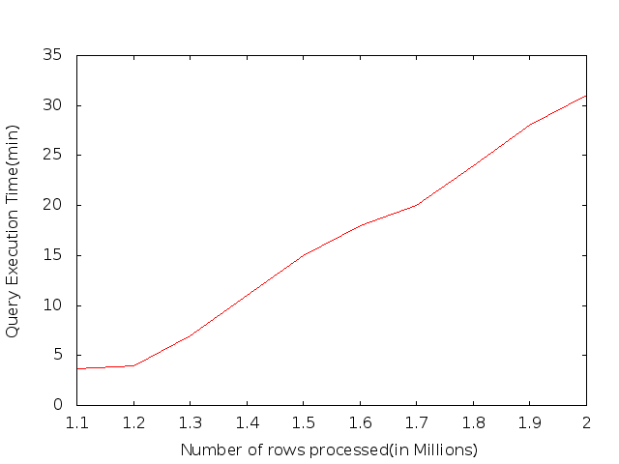
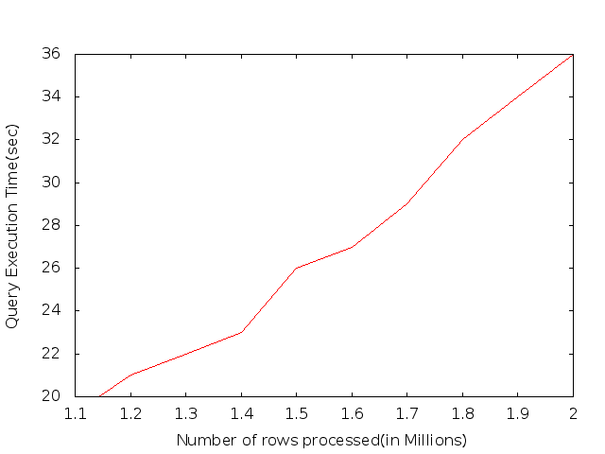
RollBack(MySql vs ClusterJ)

Slide 25
Read-Only Nested Snapshots
SNAPS
C-List
D-List
M-List
MV-List
MV-In-List
Inode_Id | Snapshot_Id | User | Time
Inode_Id | Time | Created_Inode_Id
Inode_Id | Time | Deleted_Inode_Id
Inode_Id | Time | Modified_Inode_Id | Original_Row
Inode_Id | Time | Modified_Inode_Id | Original_Row
Inode_Id | Time | Moved_In_Inode Id

Slide 26
RO-Nested Snapshots(RONS)
Block-Info C-List
Block-Info M-List
Inode_Id | Block_Id | Time
Inode_Id | Block_Id | Time | Original_Row

Slide 27
Listing files in a directory
Void ls(int stime, int pid){
  children={Get children whose parentId=id};
  children = childen - { children deleted before stime} -{ children created after stime} - {children moved_in after stime};
  children = children + {children moved-out after stime};
  modifiedChildren = { children modified after stime};
  For-each children if it is modifed first then moved then print former.
  }

Slide 28
RO-Nested Snapshots
JoinTime(JT): The time this inode joined its present path from root. Ex: /A/B/C/
Join-Time are non-decreasing on a given path from root. Ex: JT(A)<=JT(B)<=JT(C)
MaxJT(C) = Max(JT(A),JT(B),JT(C))

Slide 29
RO-Nested Snapshots
Move directoty /A/B/C/ to /U/V/W/
SN={Snapshots on A,B after MaxJT(C))
For each node in sub-tree at C
  Insert entry in InodeSnapshotMap table based on node JT. Since some nodes may have JT > JT(C), which moved into C after C moved into B.
For each node in sub-tree at C update the JT to present time.(The move time).
InodeSnapshotMap
Inode_Id | Belongs_to_Inode_Id | StartTime | EndTime
C | A | 10 | 12

Slide 30
RO-Nested Snapshots
How to determine whether an inode is in any snapshot ? Ex: /A/B/C/ Is C in any Snapshot?
Snapshots on C or
Snapshots on A or B after MaxJT or
Entry in InodeSnapshotMap with id=C.

Slide 31
RO-Nested Snapshots
Delete directory /A/B/C/
Check whether C is in any snapshot
SN={Snapshots on A,B after MaxJT(C)}
For each node in Sub-tree at C
  Set isDeleted=true
  Insert entry in InodeSnapshotMap based on it JT and SN.
Background thread deletes nodes with isDeleted=1 which are not in any snapshot.

Slide 32
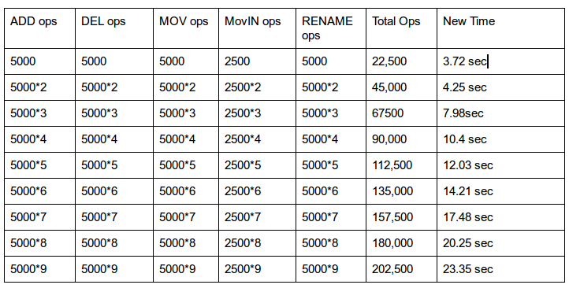
Evaluation- Nested Snapshots

Slide 33
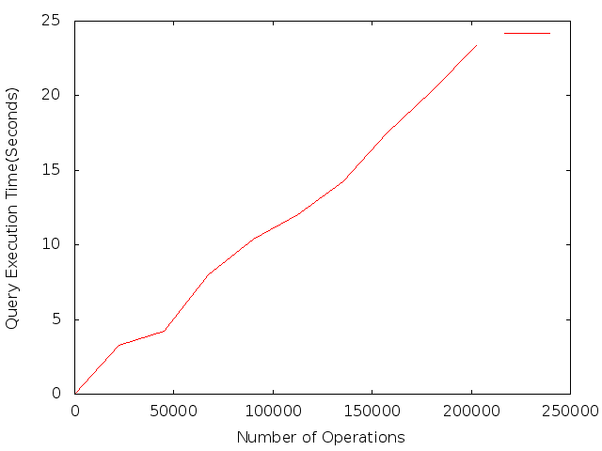
Evaluation-Nested Snapshots

Slide 34
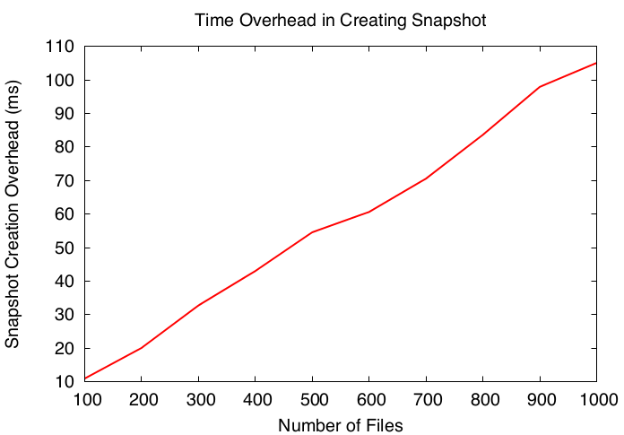
Evaluation Nested Snaphots-Facebook

Slide 35
RO-Nested Snapshots
How to determine whether an inode is in any snapshot ? Ex: /A/B/C/ Is C in any Snapshot?

Slide 36
RONS-Join Time
JoinTime(JT): The time this inode joined its present path from root.

Slide 37
RONS-Join Time
Id | Snap_Id | Time
A | SA1 | 3
/
JT:1
A
JT:2
B
JT:4

Slide 38
RONS-Join Time
Id | Snap_Id | Time
A | SA1 | 3
A | SA2 | 6
B | SB1 | 7
/
JT:1
A
JT:2
B
JT:5

Slide 39
RO-Nested Snapshots
Snapshots in which B is present
  Snapshots taken on B ={SB1}
  Snapshots taken on / after JT(B) &JT(A)={}
  And Snapshots taken on A after JT(B)={SA2}
/
JT:1
A
JT:2
B
JT:5
Id | Snap_Id | Time
A | SA1 | 3
A | SA2 | 6
B | SB1 | 7

Slide 40
Move B to A
/
JT:1
Id | Snap_Id | Time
A | SA1 | 3
B | SB1 | 6
/ | S/1 | 7
{/:7}
A
JT:2
B
JT:4
C
JT:5
E
JT:8

Slide 41
Move B to A
Id | Snap_Id | Time
A | SA1 | 3
B | SB1 | 6
/ | S/1 | 7
/
JT:1
A
JT:2
InodeSnapshotMap Table
B
JT:9
Inode_Id | Belongs_to_Inode_Id | StartTime | EndTime
B | / | 7 | 7
C | / | 7 | 7
C
JT:5
E
JT:8

Slide 42
Deletion of an inode
There should be no snapshots taken on inode
It shoud not contain any inodes with snapshots taken on them
If above are fulfilled, then mark subtree with isDeleted=1,
Background thread will look in InodeSnaphotMap table to delete permanently any inode.

Slide 43
Move A to G
Id | Snap_Id | Time
A | SA1 | 3
B | SB1 | 6
/ | S/1 | 7
A | SA2 | 10
/ | S/2 | 12
/
JT:1
{/:7,12}
A
JT:2
B
JT:9
Inode_Id | Belongs_to_Inode_Id | StartTime | EndTime
B | / | 7 | 7
C | / | 7 | 7
C
JT:5
E
JT:8
F
JT:11

Slide 44
Move C to G
/
JT:1
Id | Snap_Id | Time
A | SA1 | 3
B | SB1 | 6
/ | S/1 | 7
A | SA2 | 10
/ | S/2 | 12
G
JT:16
{/:}
{G:/},{/:}
A
JT:17
{A:/10}{G:/},{/:}
Inode_Id | Belongs_to_Inode_Id | StartTime | EndTime
B | / | 7 | 7
C | / | 7 | 7
A | / | 7 | 12
B | / | 12 | 12
C | / | 12 | 12
E | / | 12 | 12
F | / | 12 | 12
B
JT:9
{A:/10},{B:/6}
C
JT:5
E
JT:8
F
JT:11

Slide 45
Id | Snap_Id | Time
A | SA1 | 3
B | SB1 | 6
/ | S/1 | 7
A | SA2 | 10
/ | S/2 | 12
/
JT:1
G
JT:16
Inode_Id | Belongs_to_Inode_Id | StartTime | EndTime
B | / | 7 | 7
C | / | 7 | 7
A | / | 7 | 12
B | / | 12 | 12
C | / | 12 | 12
E | / | 12 | 12
F | / | 12 | 12
C | A | 10 | 10
C | B | 6 | 6
E | A | 10 | 10
A
JT:17
C
JT:18
B
JT:9
E
JT:8
F
JT:11

Slide 46
Future Work
Implementing Nested Snapshots
Integrating RO Root Level SingleSnapshot and RONetsted Snpashot solutions

Slide 47
Thank You

